Slide 1


CSE 848 Artificial Intelligence (Variational Autoencoders)
Prof. Dr. Yasar Ayaz
(Pride of Performance)
Chairman / Central Project Director
National Center of Artificial Intelligence (NCAI)
Pakistan
Professor & Founding Head
Department of Robotics & AI
NUST-SMME

Slide 2
Introduction
In 2013, Diederik P. Kingma and Max Welling published a paper¹ that laid the foundations for a type of neural network known as a variational autoencoder (VAE).
This is now one of the most fundamental and well-known deep learning architectures for generative modeling.
1- Diederik P. Kingma and Max Welling, “Auto-Encoding Variational Bayes,” December 20, 2013, https://arxiv.org/abs/1312.6114.

Slide 3
Autoencoders
An autoencoder is simply a neural network that is trained to perform the task of encoding and decoding an item.
Encoder: An encoder network that compresses high-dimensional input data such as an image into a lower-dimensional embedding vector.
Decoder: A decoder network that decompresses a given embedding vector back to the original domain (e.g., back to an image)

Slide 4
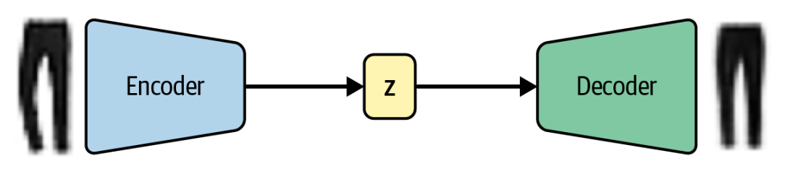
Architecture
The autoencoder is trained to reconstruct an image, after it has passed through the encoder and back out through the decoder.

Slide 5
Architecture
An input image is encoded to a latent embedding vector z, which is then decoded back to the original pixel space.
The embedding (z) is a compression of the original image into a lower-dimensional latent space.

Slide 6
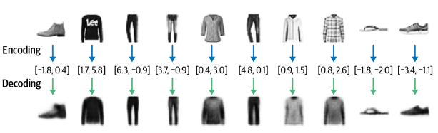
Examples of Encoding and Decoding
Reconstruction is not perfect!
There are still some details of the original images that aren’t captured by the decoding process, such as logos.
This is because by reducing each image to just two numbers, we naturally lose some information.

Slide 7
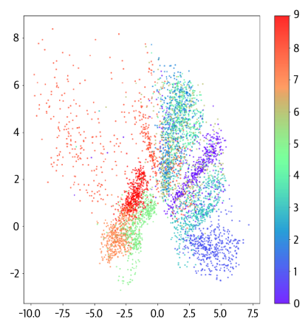
Latent Space Representation (Fashion-MNIST dataset)
Label | Category
9 | Ankle boot
8 | Bag
7 | Shirt
6 | Sneaker
5 | Sandal
4 | Coat
3 | Dress
2 | Pullover
1 | Trouser
0 | T-shirt/top
Fashion-MNIST dataset labels
Plot of the latent space, colored by clothing label.

Slide 8
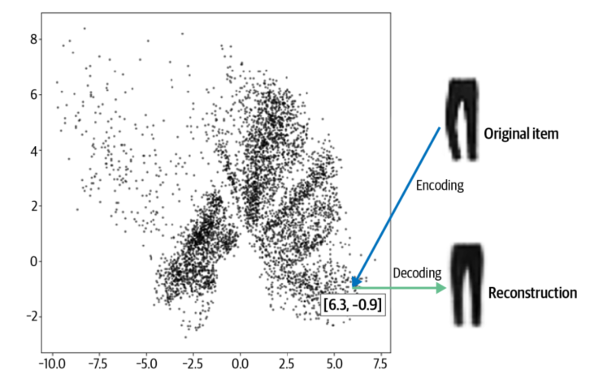
Original image to Reconstructed Image (Autoencoder)

Slide 9
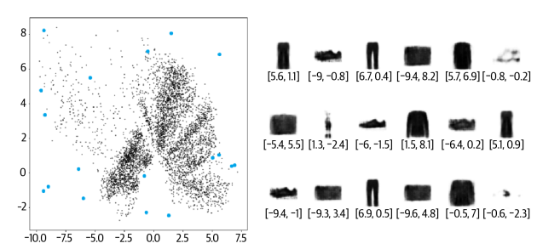
Original image to Reconstructed Image (Autoencoder)
Generated Images
Why some generated items are more realistic than others ??

Slide 10
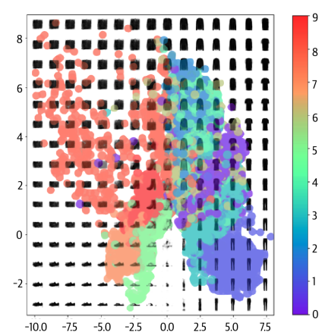
Why some generated items are more realistic than others?
Sampling points uniformly in a defined bounded space increases the likelihood of decoding a bag (ID 8) rather than an ankle boot (ID 9) because the latent space region for bags (orange) is larger than that for ankle boots (red).

Slide 11
Why some generated items are more realistic than others?
Secondly, it is not obvious how we should go about choosing a random point in the latent space, since the distribution of these points is undefined
Technically, we would be justified in choosing any point in the 2D plane!
It's not even guaranteed that points will be centered around (0, 0). This makes sampling from our latent space problematic.

Slide 12
Why some generated items are more realistic than others?
Lastly, we can see holes in the latent space where none of the original images are encoded.
For example, there are large white spaces at the edges of the domain. The autoencoder has no reason to ensure that points here are decoded to recognizable clothing items as very few images in the training set are encoded here.

Slide 13
Why some generated items are more realistic than others?
Even points that are central may not be decoded into well-formed images. This is because the autoencoder is not forced to ensure that the space is continuous. For example, even though the point (-1, -1) might be decoded to give a satisfactory image of a sandal, there is no mechanism in place to ensure that the point (-1.1, -1.1) also produces a satisfactory image of a sandal.

Slide 14
Autoencoder
In two dimensions this issue is subtle; the autoencoder only has a small number of dimensions to work with, so it has to squash things together.
What if we give the autoencoder freehand – use the latent space to encode images.

Slide 15
Variational Autoencoders
To make it a more sophisticated generative model converts autoencoder model into a variational autoencoder.

Slide 16
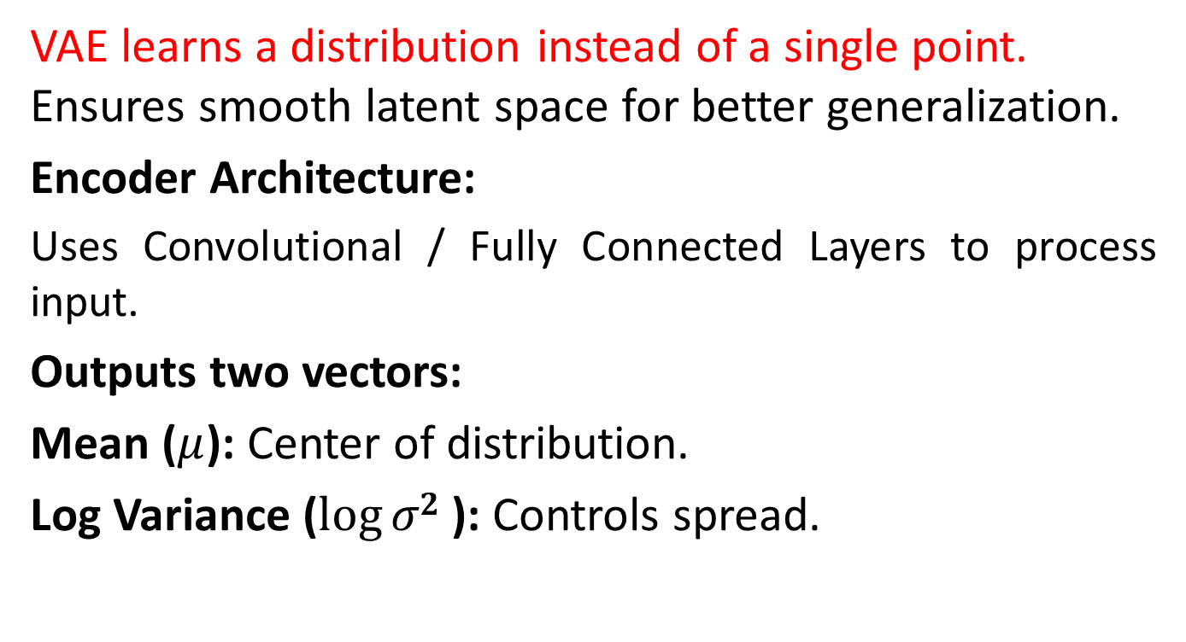
Variational Autoencoders
VAE learns a distribution instead of a single point. Ensures smooth latent space for better generalization.
Encoder Architecture:
Uses Convolutional / Fully Connected Layers to process input.
Outputs two vectors:
Mean ($μ$): Center of distribution.
Log Variance ($log⁡σ2$): Controls spread.

Slide 17
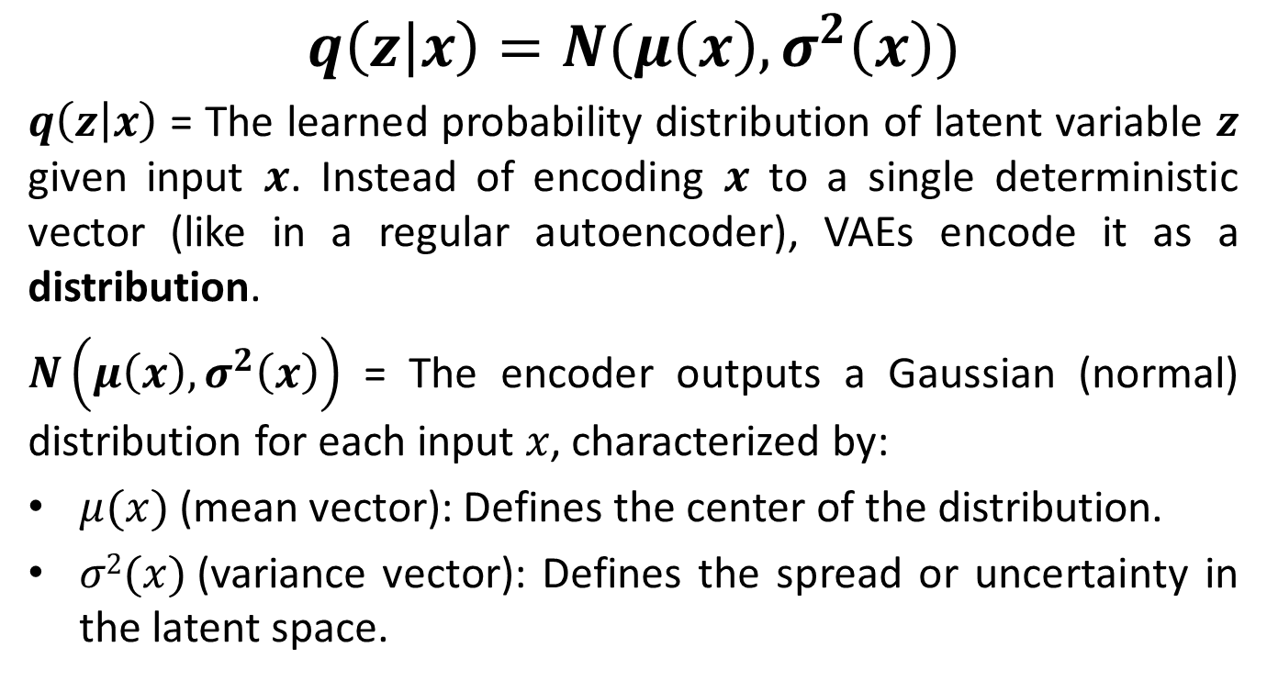
Encoder’s Formula
$$q\left(z | x\right)=N(μ\left(x\right), σ^{2}\left(x\right))$$
$q\left(z | x\right)$ = The learned probability distribution of latent variable $z$ given input $x$. Instead of encoding $x$ to a single deterministic vector (like in a regular autoencoder), VAEs encode it as a distribution.
$N\left(μ\left(x\right),σ^{2}\left(x\right)\right)$ = The encoder outputs a Gaussian (normal) distribution for each input 𝑥, characterized by:
$μ(x)$(mean vector): Defines the center of the distribution.
$σ2(x)$(variance vector): Defines the spread or uncertainty in the latent space.

Slide 18
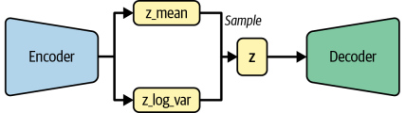
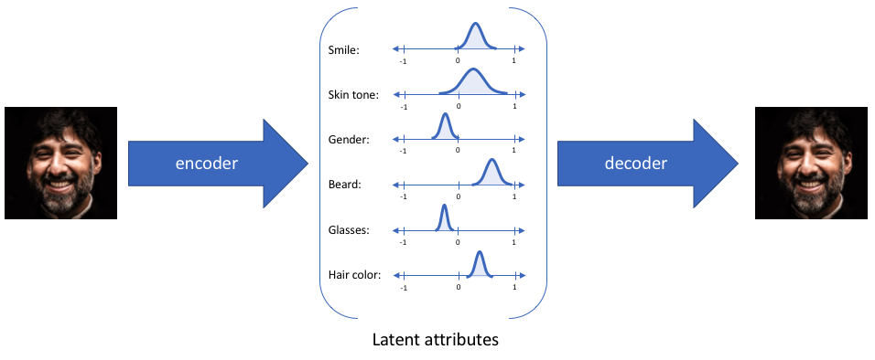
VAEs Architecture

Slide 19
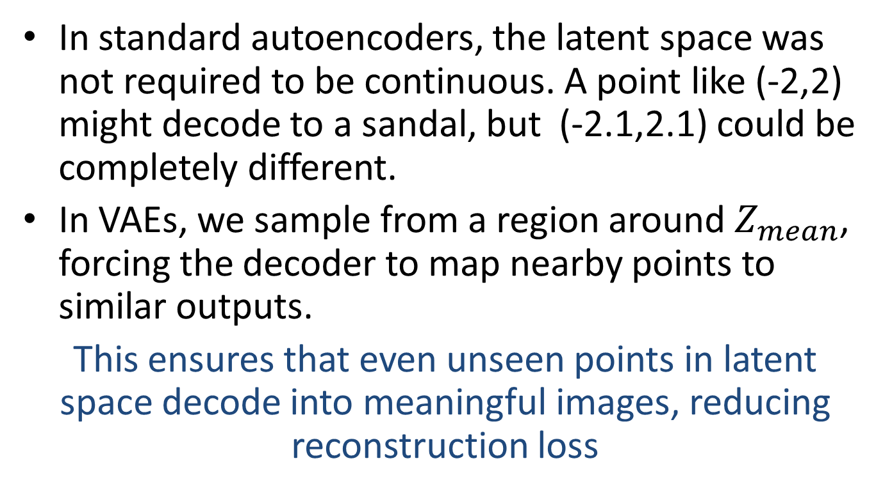
Enforcing Continuity in Latent Space
In standard autoencoders, the latent space was not required to be continuous. A point like (-2,2) might decode to a sandal, but (-2.1,2.1) could be completely different.
In VAEs, we sample from a region around $Z_{mean}$, forcing the decoder to map nearby points to similar outputs.
This ensures that even unseen points in latent space decode into meaningful images, reducing reconstruction loss

Slide 20
Reading Assignment
Understand VAE loss from Chapter 3 of the book, focusing on:
Explain why VAEs use a probabilistic latent space.
Understand Reconstruction Loss in training.
Interpret KL Divergence and its effect on latent space.
Analyze the trade-off between both loss components.

